Slide 1


Seasonal Agriculture Performance Analysis
Deepika Singh
Jaypee University of Information Technology (JUIT), Solan
AICTE STU ID : STU6a42109bdaccf1782714523
9/3/2026
Annual Review
‹#›

Slide 2

PROBLEM STATEMENT
Agricultural performance is shaped by seasonal shifts in rainfall, temperature, humidity and resource use — but raw farm-level data alone does not reveal how yield, cost and profitability actually change across seasons.
This project analyzes a multi-state seasonal farming dataset (4,000 farm records) to uncover meaningful seasonal patterns, trends, relationships and variations in agricultural performance.
The goal is to move from raw data to evidence-based insight — identifying which seasons, crops and practices perform best, and why — to support better seasonal agricultural planning.
9/3/2026
Annual Review
‹#›

Slide 3
Project Description
This project applies exploratory data analysis and visualization to a dataset of 4,000 farm records spanning three cropping seasons — Kharif, Rabi and Zaid — across 8 states, 10 districts and 8 crops.
Using Python (Pandas, NumPy, Matplotlib, Seaborn) in a Jupyter Notebook, the raw data is cleaned, explored and analyzed to compare yield, cost, revenue, profit, resource usage (water, fertilizer, pesticide) and disease/pest risk across seasons, crops, states and irrigation methods.
Correlation analysis and comparative visualizations are used to surface the strongest drivers of seasonal performance and translate them into practical, data-driven recommendations.
9/3/2026
Annual Review
‹#›

Slide 4

WHO ARE THE END USERS?
Farmers & agricultural cooperatives — choosing the right crop, irrigation method and inputs for each season
State agriculture departments & policymakers — seasonal planning, resource allocation and subsidy targeting
Agri-fintech & crop-insurance providers — season- and crop-based risk assessment and pricing
Agribusiness & supply-chain planners — anticipating seasonal production, pricing and demand shifts
Agricultural researchers & students — benchmarking and studying seasonal performance trends
9/3/2026
Annual Review
‹#›

Slide 5

Technology Used
Python 3 — Pandas & NumPy for data cleaning, transformation and aggregation
Matplotlib & Seaborn — statistical charts and correlation visualizations
Jupyter Notebook — documented, reproducible end-to-end analysis
CSV / Microsoft Excel — source dataset (4,000 farm records, 28 features)
Git & GitHub — version control and project submission
9/3/2026
Annual Review
‹#›

Slide 6
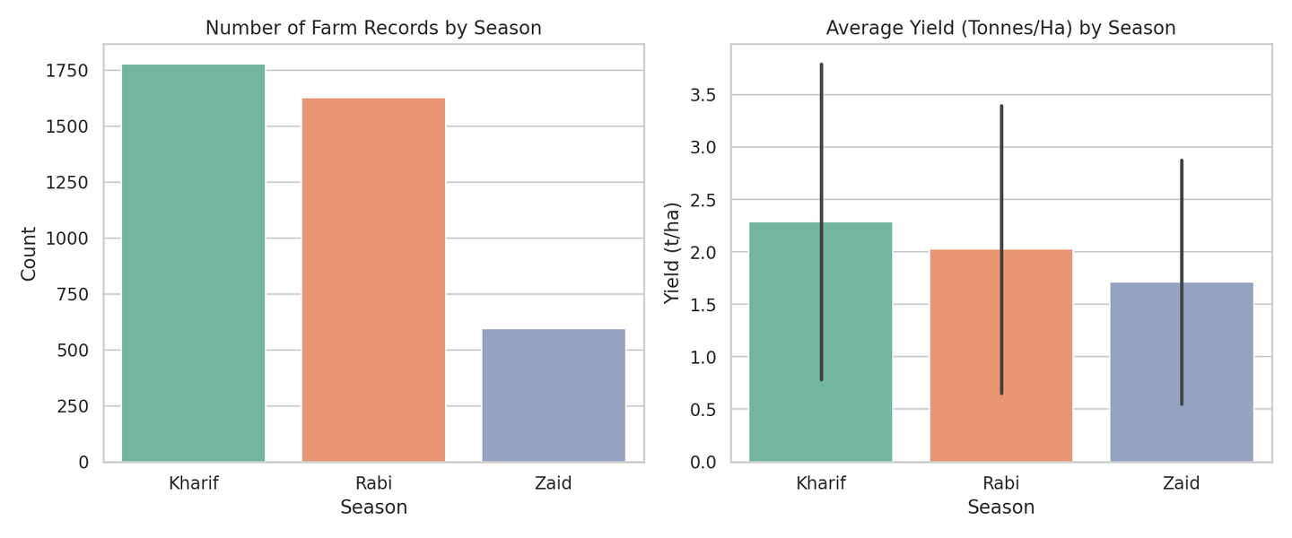
RESULTS: Season-wise Data Spread & Yield
Key Insights
• Kharif has the most farm records (1,779), followed by Rabi (1,627) and Zaid (594).
• Kharif shows the highest average yield (~2.29 t/ha), followed by Rabi (~2.03 t/ha).
• Zaid records the lowest average yield (~1.71 t/ha) despite fewer farms.
9/3/2026
Annual Review
‹#›

Slide 7
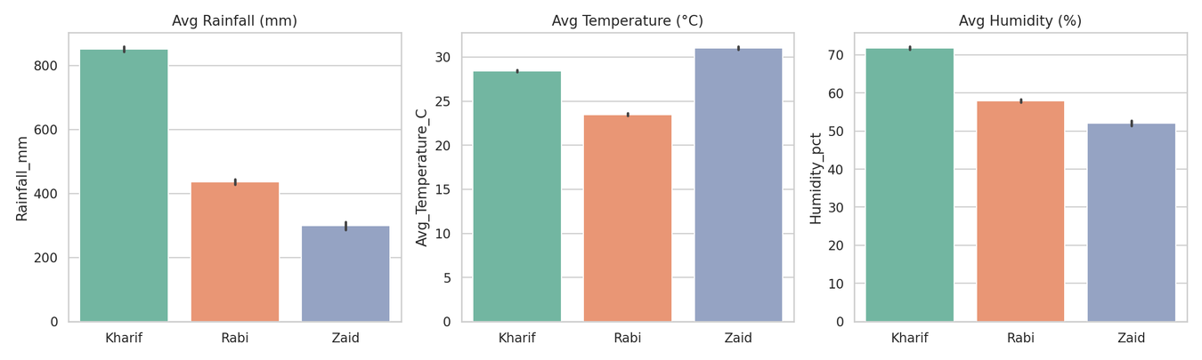
RESULTS: Seasonal Climate Conditions
Key Insights
• Kharif receives far more rainfall (~852 mm) than Rabi (~436 mm) or Zaid (~299 mm).
• Zaid is the hottest season (~31°C) but also the driest and least humid.
• Rabi is the coolest season (~23.5°C), suiting winter crops like wheat and pulses.
9/3/2026
Annual Review
‹#›

Slide 8
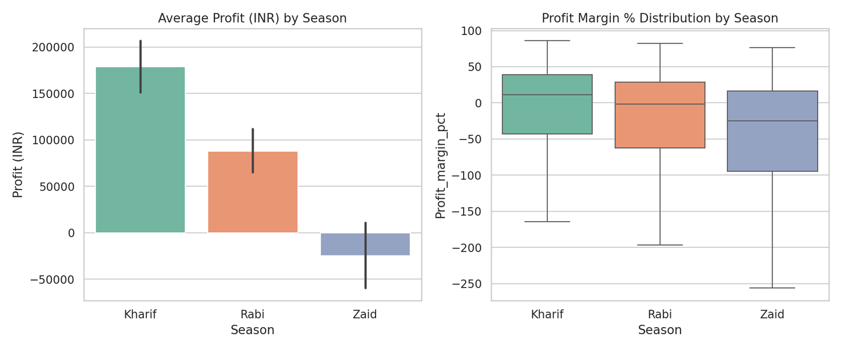
RESULTS: Economic Performance by Season
Key Insights
• Average profit is highest in Kharif (~₹1.79 lakh) and turns negative in Zaid (~₹−25K).
• Profit margins average negative in every season — production costs often exceed revenue.
• Zaid shows the widest, most negative profit-margin spread — the riskiest season economically.
9/3/2026
Annual Review
‹#›

Slide 9
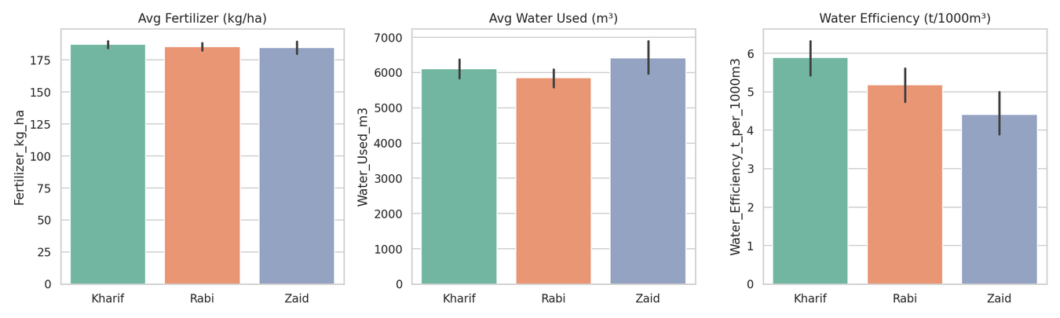
RESULTS: Resource Usage & Water Efficiency
Key Insights
• Fertilizer use is nearly constant across seasons (~185–187 kg/ha) — not a seasonal differentiator.
• Water efficiency is highest in Kharif (5.89 t/1000m³) and lowest in Zaid (4.41 t/1000m³).
• Water volume used is similar across seasons — efficiency, not volume, separates strong seasons.
9/3/2026
Annual Review
‹#›

Slide 10
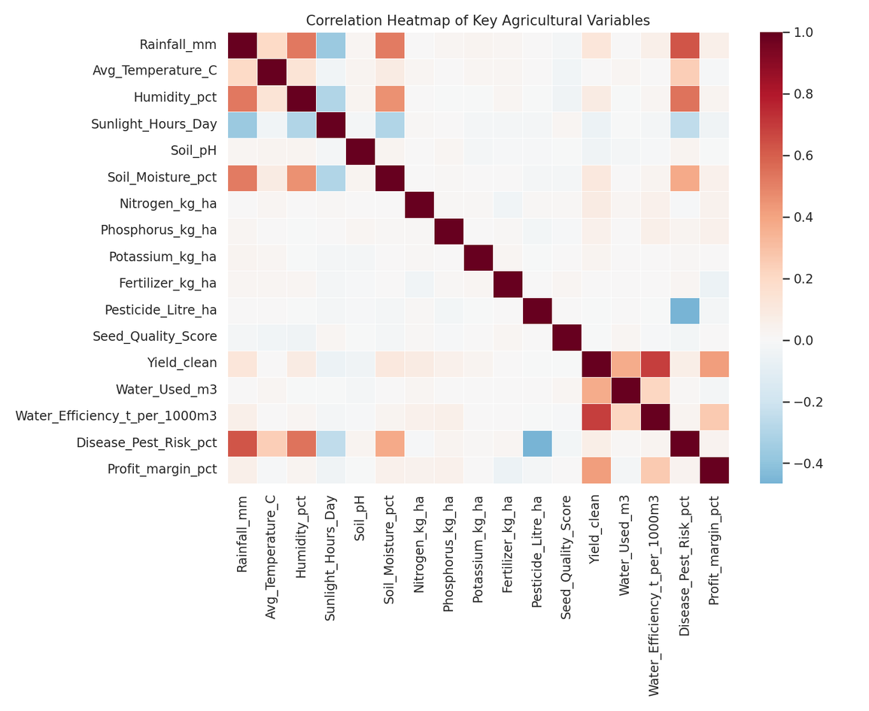
RESULTS: Key Relationships (Correlation Analysis)
Key Insights
• Water efficiency has the strongest positive correlation with yield (r ≈ 0.69).
• Profit margin correlates positively with yield (r ≈ 0.42); rainfall & soil moisture show weak links.
• Fertilizer, pesticide use and soil pH show almost no correlation with yield.
• Overall: YES — the dataset yields clear, actionable insight. It shows irrigation efficiency (not input volume) drives yield, and that Zaid is a consistently high-risk season economically.
9/3/2026
Annual Review
‹#›

Slide 11
Future scope
• Build a predictive model (regression / ML) to forecast season-wise yield and profit before the season begins.
• Integrate real-time weather forecasts and market-price feeds for dynamic, up-to-date seasonal planning.
• Develop an interactive dashboard (Power BI / Streamlit) so farmers and policymakers can explore results directly.
• Incorporate soil-health and satellite / remote-sensing data for finer-grained seasonal insight.
• Expand the dataset to more states, districts and multiple years to study year-on-year seasonal trends.
9/3/2026
Annual Review
‹#›

Slide 12
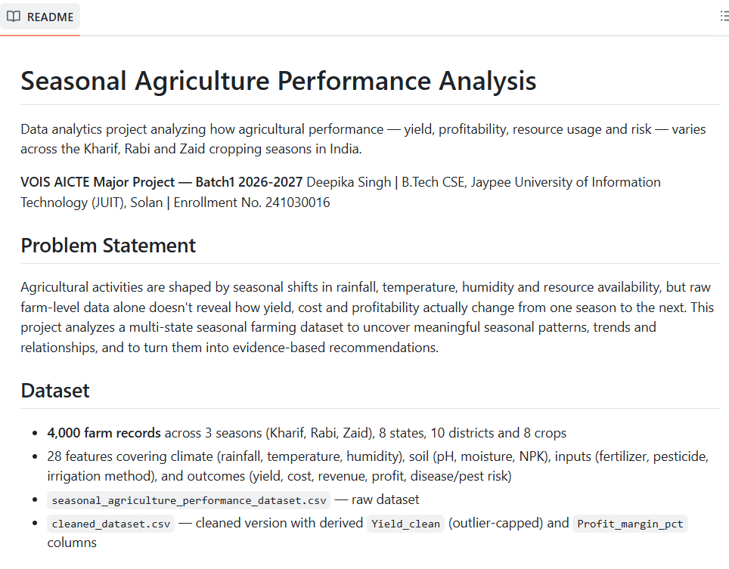
GitHub Link
Project Repository:
github.com/deepikasingh28102005-eng/seasonal-agriculture-performance-analysis
9/3/2026
Annual Review
‹#›

Slide 13
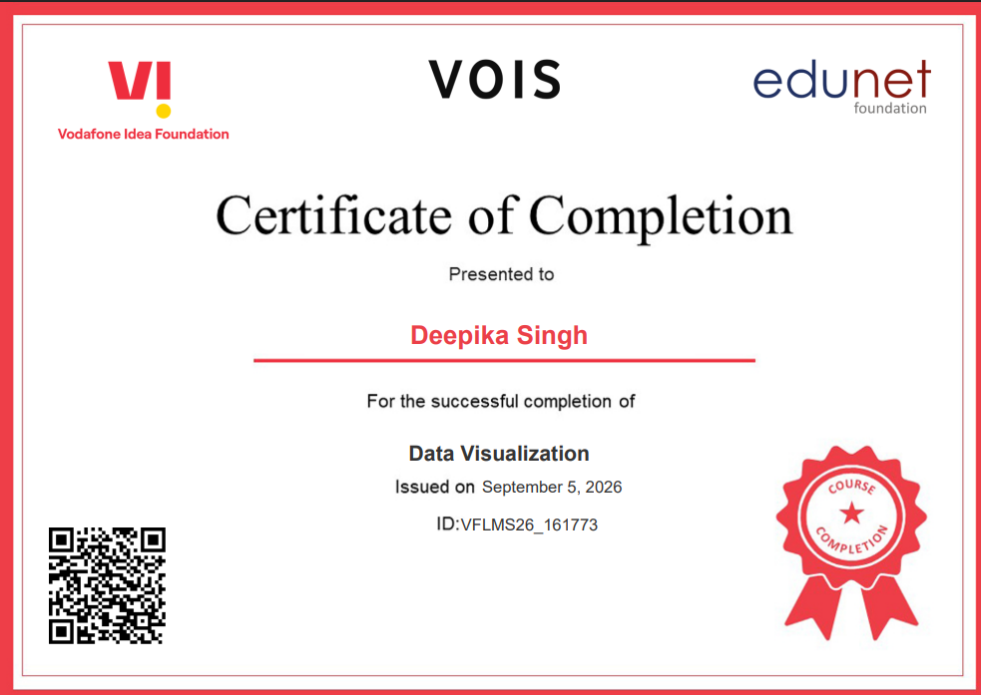
VOIS Course completion certificate -
Course name- Data Visualization
9/3/2026
Annual Review
‹#›

Slide 14
Thank you
Deepika Singh
B.Tech CSE, Jaypee University of Information Technology (JUIT), Solan
Enrollment No. 241030016
Linkedin: www.linkedin.com/in/deepika-singh28
9/3/2026
Annual Review
‹#›

